Slide 1
MLPs
Neural Networks

Slide 2
Linearly Non-separable Problems
As mentioned before, perceptrons are limited by their linear decision boundaries and are unable to solve linearly non-separable problems.
In these cases, we can use more advanced techniques, such as kernel methods or multi-layer neural networks, to transform the input data into a higher-dimensional space where it becomes linearly separable.
For example, the XOR problem is a classic example of a linearly
non-separable problem that cannot be solved by a single perceptron.

Slide 3
Multi-layer Neural Networks
Multi-layer neural networks (also called feedforward neural networks) consist of multiple layers of perceptrons, allowing them to learn
non-linear decision boundaries.
Each layer of the network consists of a set of neurons, with the output of each neuron serving as input to the neurons in the next layer.
The layers between the input and output layers are called hidden layers.
The backpropagation algorithm is used to train multi-layer neural networks by minimizing the error between the predicted output and the true output.

Slide 4
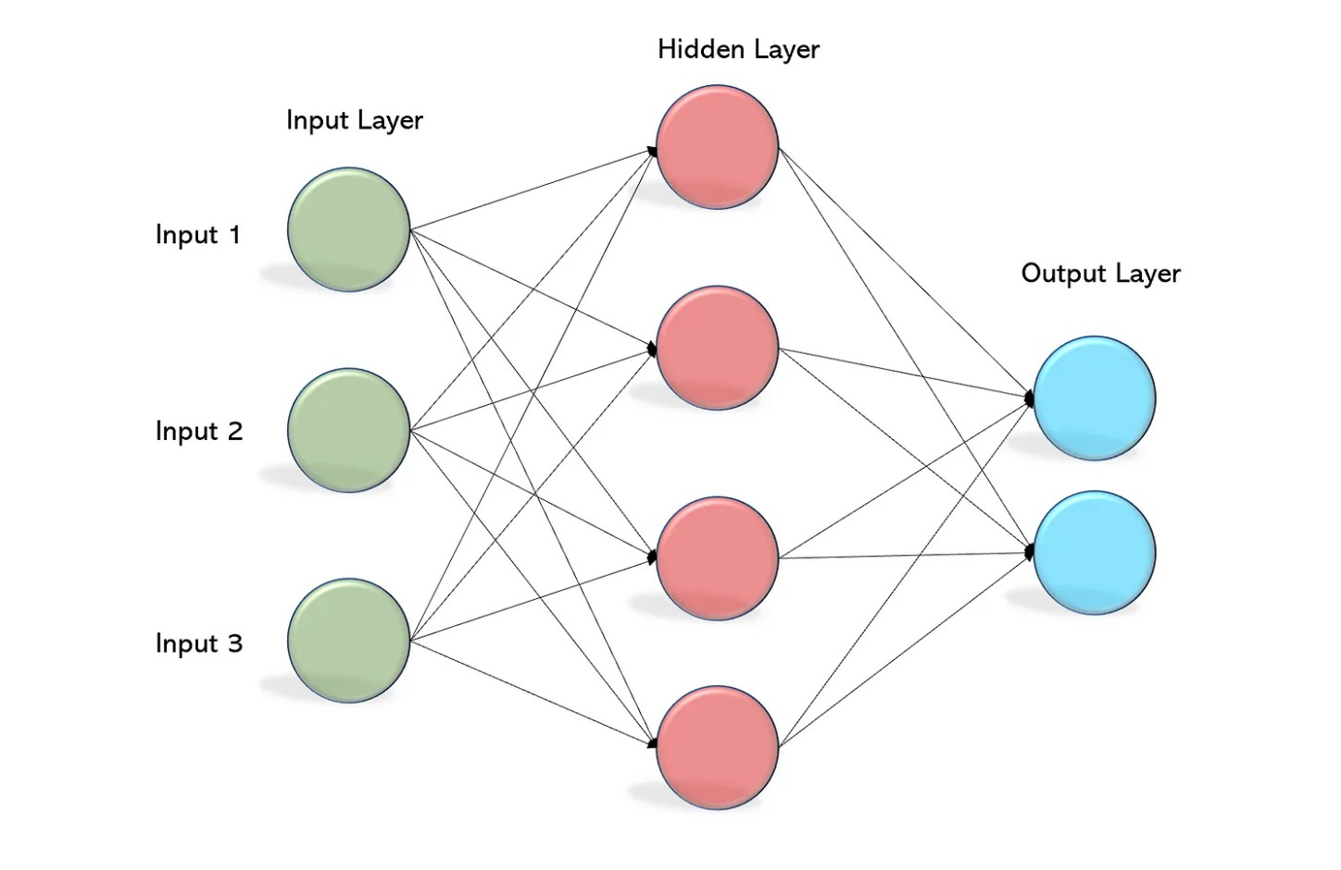
Multi-Layer Perceptron (MLP)

Slide 5
Activation Functions
In multi-layer neural networks, activation functions other than the step function are often used to introduce non-linearity.
Common activation functions include the sigmoid function, hyperbolic tangent (tanh) function, and Rectified Linear Unit (ReLU) function.
These functions introduce non-linear transformations to the weighted sum of the inputs, allowing the network to learn more complex decision boundaries.

Slide 6
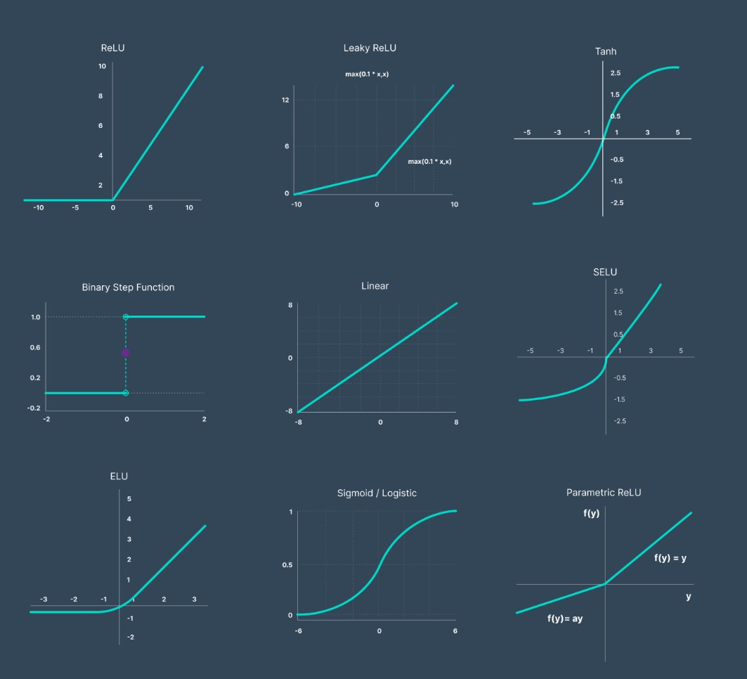
Activation Functions in MLP

Slide 7
Sigmoid Function
The sigmoid function is a popular activation function for neural networks, given by the equation:
1
f (x ) = _{1 + e−x}
The sigmoid function maps input values to the range (0, 1), with a smooth S-shaped curve.
It is differentiable, which makes it suitable for use with the backpropagation algorithm.

Slide 8
Hyperbolic Tangent (tanh) Function
The hyperbolic tangent (tanh) function is another popular activation function, given by the equation:
f (x ) = tanh(x ) = ^{ex − e−x}
_{e}x _{+ e}−x
The tanh function maps input values to the range (-1, 1), with a smooth curve that is similar to the sigmoid function.
It is also differentiable, making it suitable for use with the backpropagation algorithm.
The tanh function often performs better than the sigmoid function in hidden layers, as its output is zero-centered, which can help mitigate the vanishing gradient problem.

Slide 9
Rectified Linear Unit (ReLU) Function
The Rectified Linear Unit (ReLU) function is another widely-used activation function, given by the equation:
f (x ) = max(0, x )
The ReLU function maps input values to the range [0, ∞), with a piecewise linear curve.
It is computationally efficient and helps mitigate the vanishing gradient problem.
However, ReLU units can suffer from the "dying ReLU" problem, where some neurons become inactive and do not contribute to the learning process.

Slide 10
Multi-Layer Perceptron (MLP)
To overcome the limitations of the perceptron, we can stack multiple perceptrons together to create a more complex neural network, called a Multi-Layer Perceptron (MLP).
An MLP consists of an input layer, one or more hidden layers, and an output layer.
Each layer consists of multiple perceptrons (or neurons), which are connected to the neurons in the adjacent layers.
The connections between the neurons have associated weights, which are learned during the training process.

Slide 11
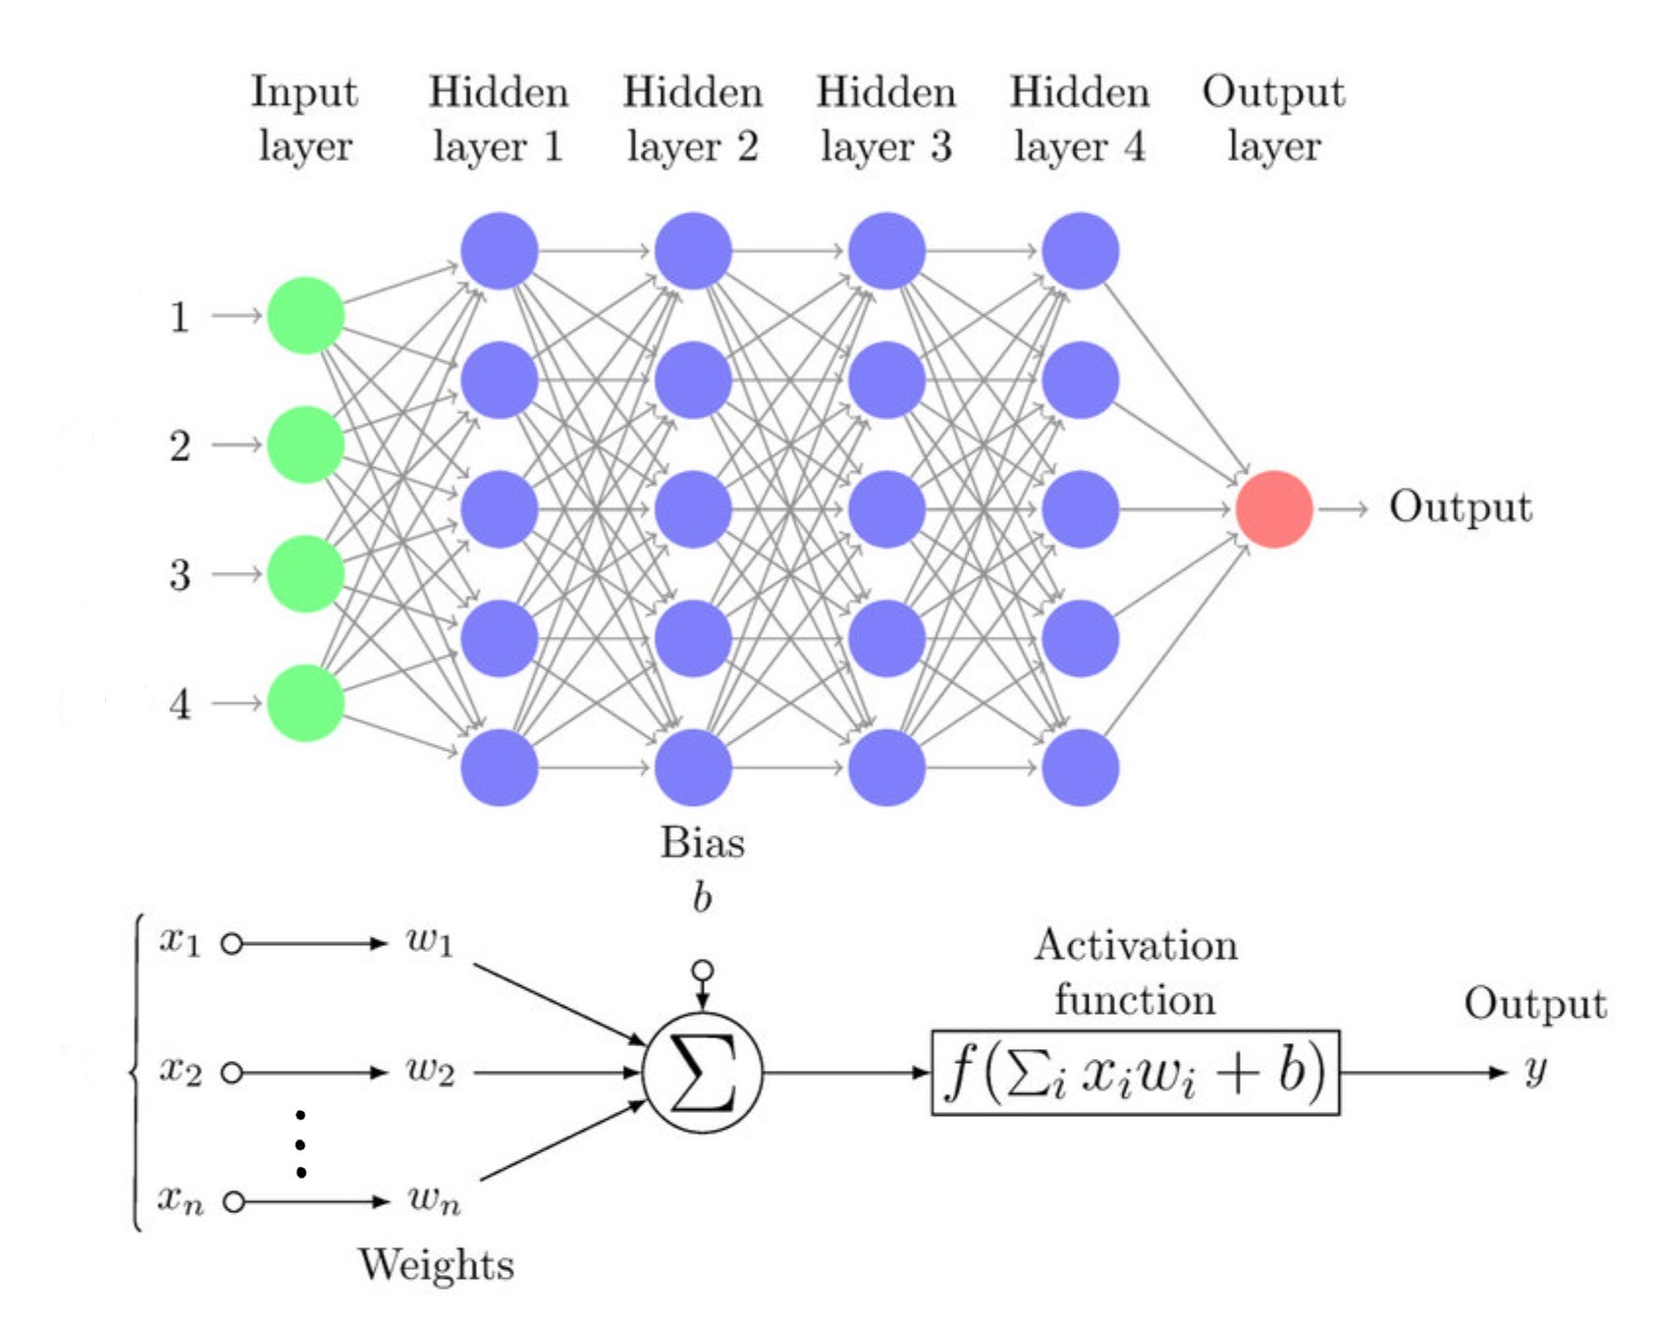
Multi-Layer Perceptron (MLP)

Slide 12
Activation Functions in MLP
In an MLP, we typically use non-linear activation functions, such as the sigmoid or ReLU functions, instead of the step function used in the basic perceptron model.
This allows the MLP to learn non-linear decision boundaries, which can result in better performance on complex tasks.
Some commonly used activation functions are:
Sigmoid: f (x ) =
1
1+e
−x
x −x
Hyperbolic Tangent (tanh): f (x ) = ^{e −e}
_{e}x _{+e}−x
Rectified Linear Unit (ReLU): f (x ) = max(0, x )

Slide 13
Two-Layer Perceptron Solving XOR Problem
The network structure:
  Input layer: 2 neurons (for the two input features)
  Hidden layer: 2 neurons (with activation functions)
  Output layer: 1 neuron (for the XOR output)

Slide 14
Two-Layer Perceptron Solving XOR Problem: Example
Suppose we define the following two-layer perceptron with pre-determined weights and biases:
The hidden layer neurons use the following activation functions:
  Neuron 1: ReLU
  Neuron 2: ReLU
The output layer neuron uses the following activation function:
  Neuron 3: step function
Can we come up with weights and biases for this two-layer perceptron that can correctly compute the XOR function for all possible inputs?

Slide 15
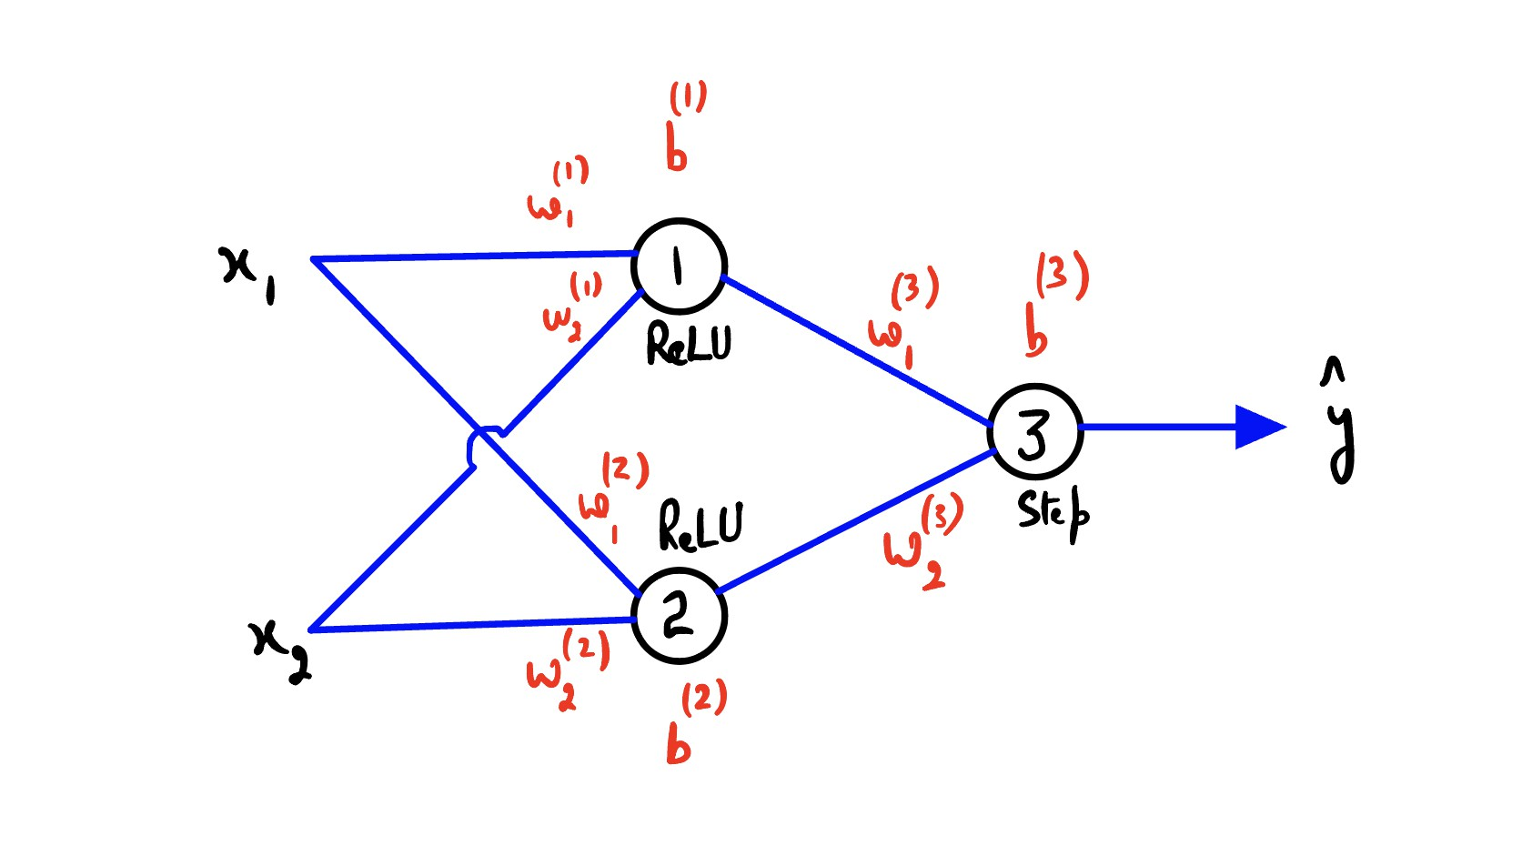
Two-Layer Perceptron Solving XOR Problem: Example

Slide 16
Forward Propagation
Forward Propagation is the process of passing the input data through the layers of the MLP to obtain an output.
At each layer, the input is multiplied by the weight matrix, and the resulting product is passed through the activation function.
This process continues until the output layer is reached.

Slide 17
Backpropagation
Backpropagation is a learning algorithm used to train MLPs.
It is a supervised learning algorithm that adjusts the weights in the network by minimizing the difference between the predicted output and the target output.
It uses the chain rule of calculus to compute gradients of the loss function with respect to the weights, and then updates the weights using gradient descent.
The process is repeated iteratively until the network converges to a set of weights that produce the desired output.

Slide 18
Loss Functions
A loss function is used to measure the difference between the predicted output and the target output.
The goal of training is to minimize the value of the loss function.
Some commonly used loss functions are:
Mean Squared Error (MSE): L(y , yˆ) =
1
m
_{(y} (i) _{− yˆ}(i)₎2
Σ
Cross-Entropy Loss:
M i=1
m
y ^{(i)} log(yˆ^{(i)}) + (1 − y ^{(i)}) log(1 − yˆ^{(i)})
L(y , yˆ) = −
Σ
i=1
Hinge Loss: L(y , yˆ) =
m
max(0, 1 − y ^{(i)}yˆ^{(i)})
Σ
i=1
Different loss functions are suited for different tasks and can greatly impact the performance of the MLP.

Slide 19
Chain Rule and Gradients
The chain rule of calculus is used to compute the gradient of the loss function with respect to the weights.
For each weight w_{ij} connecting neuron i in layer l − 1 to neuron j in
layer l , we compute the gradient ^{∂L} .
∂w_{ij}
This gradient is calculated using the chain rule:
∂L ∂L
∂a^{l} ∂z^{l}
j j
= · ·
∂wij ∂a^{l} ∂z^{l} ∂wij
j j
where a^{l} is the activation of neuron j in layer l , z^{l} is the weighted sum
j j
of inputs to neuron j in layer l , and w_{ij} is the weight connecting neuron i in layer l − 1 to neuron j in layer l .

Slide 20
Weight Update Rule
The weights are updated using gradient descent, which adjusts the weights in the direction of the negative gradient to minimize the loss function.
The weight update rule is given by:
∂L
w_{ij} ← w_{ij} − η _{∂w}
ij
Where η is the learning rate, a hyperparameter that controls the step size of the weight updates.

Slide 21
Backpropagation Algorithm
Perform a forward pass through the network to compute the predicted output.
Calculate the loss function and its gradients with respect to the weights using the chain rule.
Update the weights using gradient descent.
Repeat steps 1-3 until convergence or a predefined number of iterations is reached.

